Slide 1

Descriptive Analysis of the home sales dataset Project Phase1
Prafull Pandey
BAN 502 Predictive Analytics

Slide 2
Data Observation
No blank/NA is observed
80 predictors and one response variable with a total of 81 variables and 2053 observations.
Response variable Above_Median is a nominal variable
47 characters and 34 numeric variables in the dataset
The mutation of response variable in numeric would require to examine all quantitative variable correlation.
All the character variables required to translate into factors.
Some outliers are observed with both continuous and nominal variables and might require data fitting during model development to avoid overfitting.
The "ggpairs" plot would require to analyze the possible correlation of all the variables with the response variable.
Mostly, the box plot is recommended for continuous variables and the bar chart for nominals.

Slide 3
Selection of Variables
Based on correlation analysis, the combination of character and number variables was selected.
These variables reflected the greater value of standard deviation and stronger correlation on the positive side. The greater standard deviation means more patterns in data and might protect from overfitting.
Most of the character and numeric variables are dropped because of inconclusive relation with the response variable.
17 variables are considered based on datasets and their relationship with the response variable
Variables:
Above_Median : Character
Lot_Config : Character
Overall_Qual : Character
Neighborhood : Character
Bldg_Type : Character
House_Style : Character
Exterior_2nd : Character
Bsmt_Exposure : Character
BsmtFin_Type_1: Character
Heating_QC : Character
Garage_Finish : Character
Garage_Qual : Character
Year_Built : Number
Year_Remod_Add: Number
Gr_Liv_Area : Number
Fireplaces : Number
Garage_Cars : Number
Garage_Area : Number

Slide 4
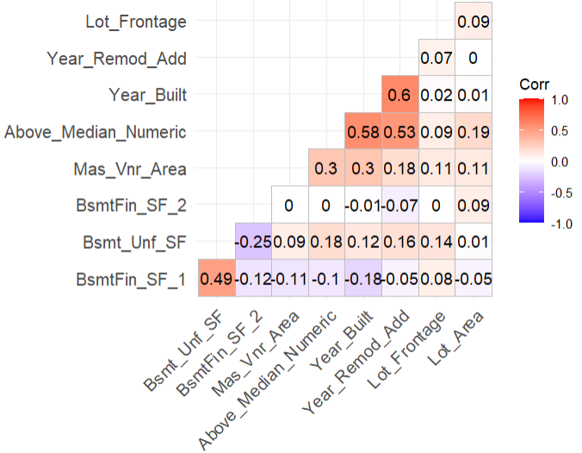
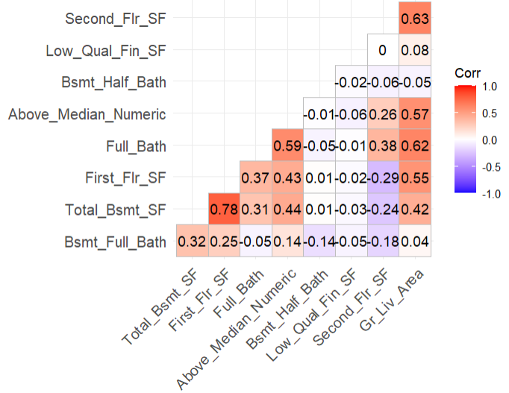
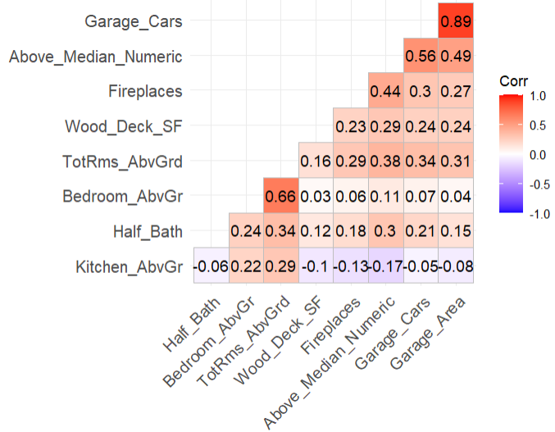
Variables Analysis (Quantitative variables)
Correlation: Year_Built (0.58), Year_Remod_Add (0.53),Gr_Liv_Area (0.57),Garage_Cars(0.56), and Garage_Area 0.49 reflecting strong corelation with mutated response variable Above_Median_Numeric.
**There are 10 more variables with poor correlation and has not been present in above bar graphs.
** Above_Median_Numeric is a mutated response variable for analysis.
Multicollinearity: ( Correlation of other variables with each other instead with response variable Above_Median ):
Year_Built and Year_Remod_Add have colinearity of 0.6 that means strongly related.
Gr_Liv_Area have strong correlation with Full_Bath, First_Flr_SF, Second_Flr_SF and Total_Bsmt_SF while the First_Flr_SF have strong correlation with Total_Bsmt_SF.
Garage_Cars have strong correlation (0.89) with Garage_Area.

Slide 5
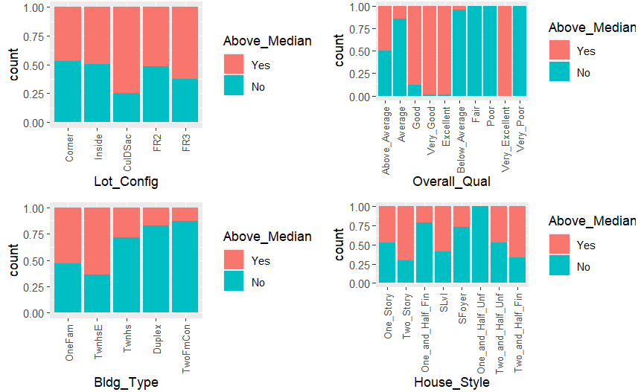
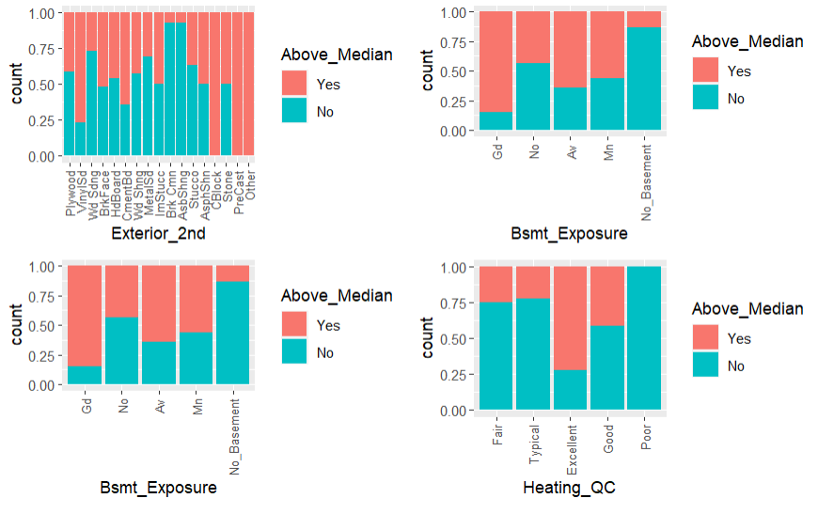
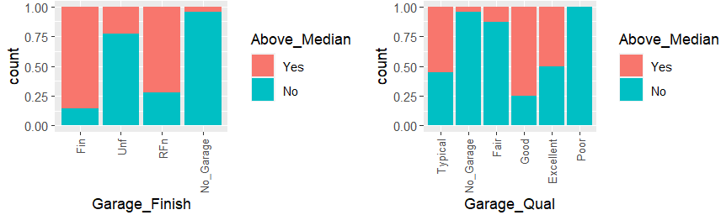
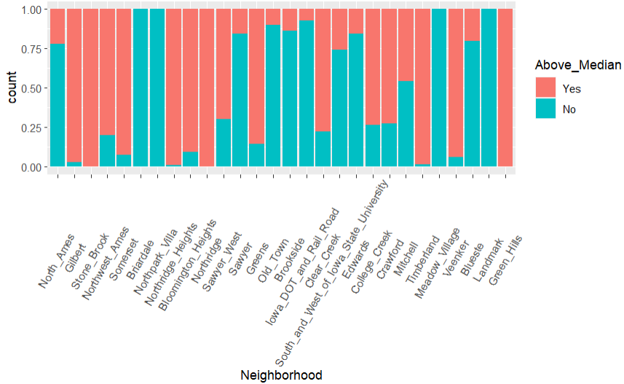
Variables Analysis (Factor variables)
All variables are reflecting the pattern of correlation with response variable Above_Meadian in bar graphs.

Slide 6
Summary
Exploration of 17 variables revealed a potentially positive relationship with the response variable (RV), "Above_Median“ in bar and correlation graphs.
Total of 18, including one response variable(RV) has been identified for the dataset.
Initially, 11 factor and 6 number variables were selected for the model due to their possible strong relationship and diverse nature within the dataset.
All character variables were converted into factors to enhance their analysis and interpretation.
New variable Above_Median_Numeric was mutated to allow correlation analysis of quantitative variables with RV.
Eliminating nominal variables with repetitive values for a more focused analysis.
Nominal variables Neighborhood(28), Overall_Qual(10), Exterior_2nd(17), and MS_SubClass(16) have the highest unique patterns of data in brackets, so they are included for model preparation to avoid overfitting of the future model.
Continuous variables were also eliminated as reflected poor correlation with the response variable.
Variables with higher standard deviation were preferred to capture diverse patterns and improve predictability, minimizing the risk of overfitting.
The "ggpairs" plot analysis highlighted Neighborhood, Heating_QC, and MS SubClass as variables showing a possible strong relationship with the response variable.
The reduction in the number of observations did not significantly impact the overall analysis, including the full volume of observations.

